Slide 1
Bit shift operations
Left Shift: x << y
Shift bit-vector x left y positions
Throw away extra bits on the left
Fill with 0’s on right
Right Shift: x >> y
Shift bit-vector x right y positions
Throw away extra bits on the right
Logical shift
Fill with 0’s on left
Arithmetic shift
Replicate most significant bit on left
Undefined Behavior
Shift amount < 0 or ≥ word size
Argument x
01100010
00010000
00010000
<< 3
00010000
>> 2
00011000
00011000
00011000
Argument x
10100010
00010000
00010000
<< 3
00010000
Log. >> 2
00101000
00101000
00101000
Arith. >> 2
11101000
11101000
11101000
If there is anything you are not clear, write some codes and see what happens.

Slide 2
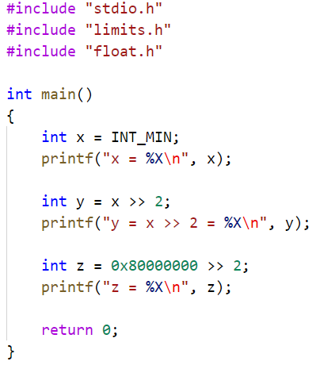
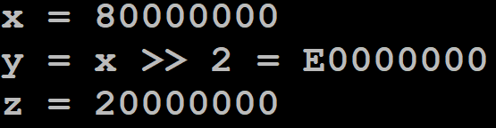
Bit shift operations
Why z is 20000000, instead of E0000000?
0x80000000 is an immediate number, not declared as “int”. So the compiler takes 0x80000000 as an unsigned int number, and thus the right shift fills the higher bits with 0s instead of 1s

Slide 3
Bit shift operations
Left shift
The bits shifted in from the right will always be zero
Special attention needs to be paid on the overflow problem, if the shifted bit vector will be explained (by the program) as signed integer/unsigned integer
Right shift
Right shift have two versions: logical shift, higher bits filled by 0s; arithmetic shift, higher bits filled by 1s.
Which right shift is taken is the compiler’s choice
Different compilers may have different understanding of the program and different operations
Always test the shift operations on a computer, fully understand the compiler’s choice

